Slide 1
Recommender Systems
Oualid Missaoui

Slide 2
Agenda
Introduction
Taxonomy
Collaborative filtering
Matrix Factorization
AutoRec
BPR
Neuro Collaborative Filtering
Factorization Machines

Slide 3
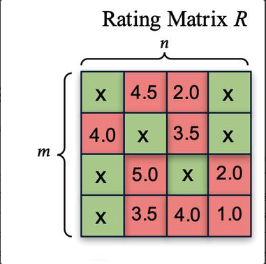
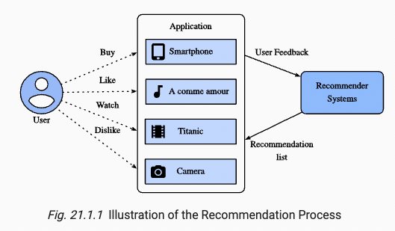
Introduction
Source

Slide 4
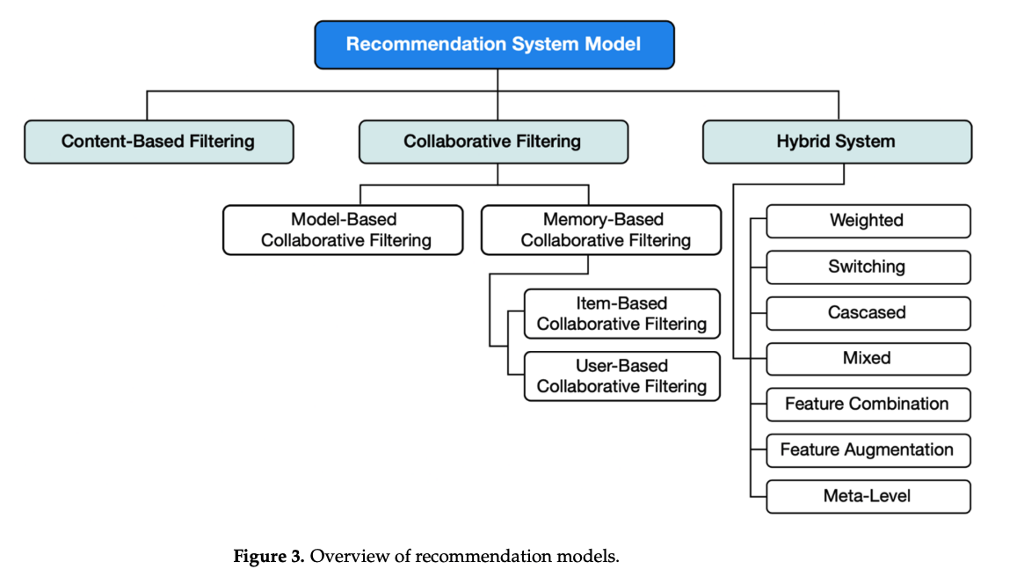
Taxonomy of Recommendation systems
source

Slide 5
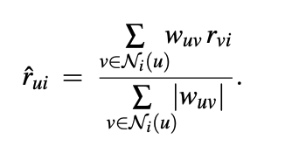
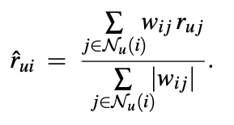
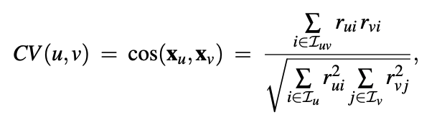
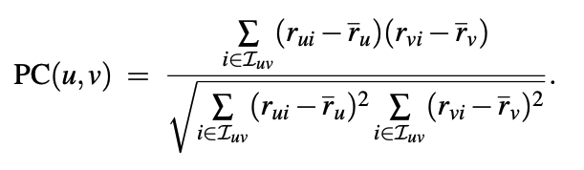
Neighborhood (Memory) Based RecSys
User based
Item based
Similarities
Source

Slide 6
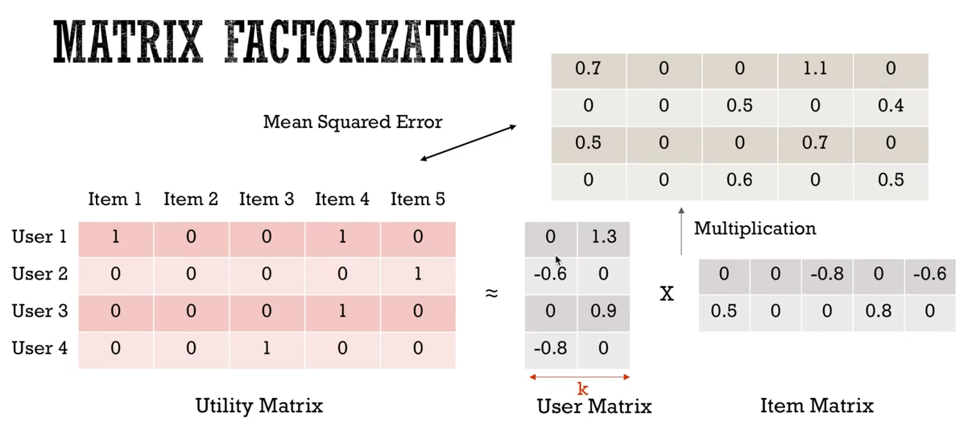
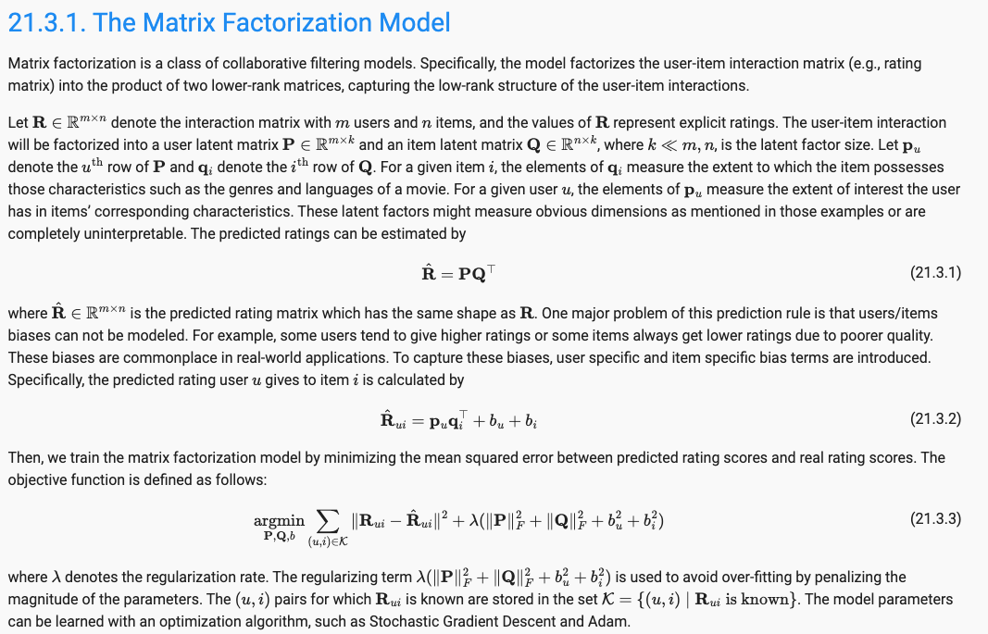
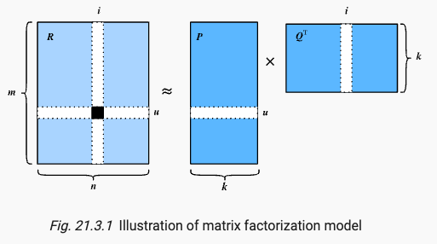
Matrix Factorization

Slide 7
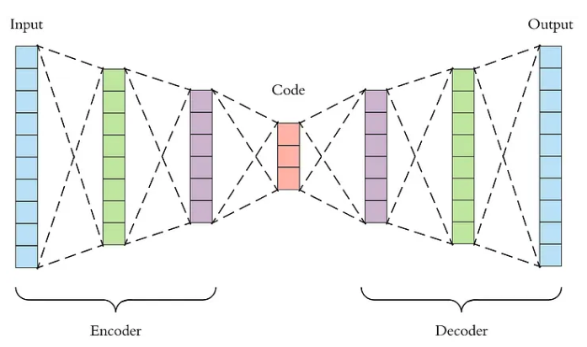
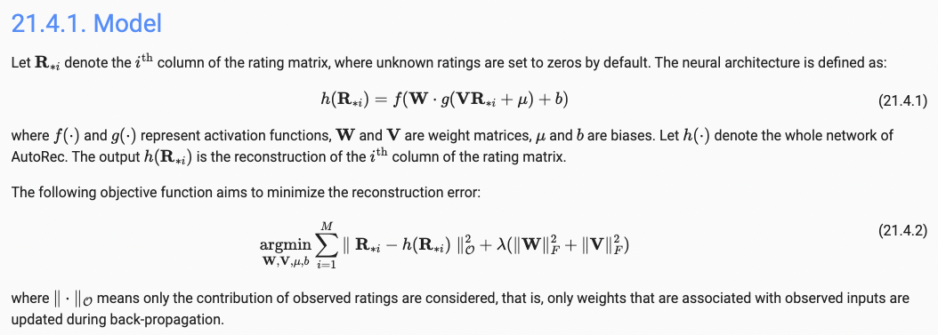
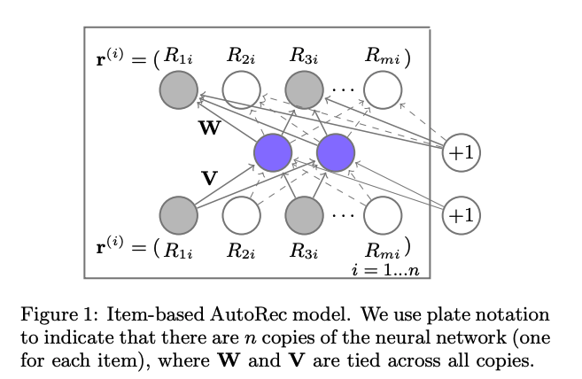
AutoRec: Rating Prediction with Autoencoders
Source: Sedhain et al, 2015, AutoRec: Autoencoders Meet Collaborative Filtering

Slide 8
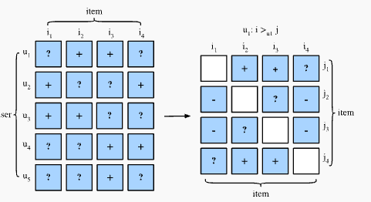
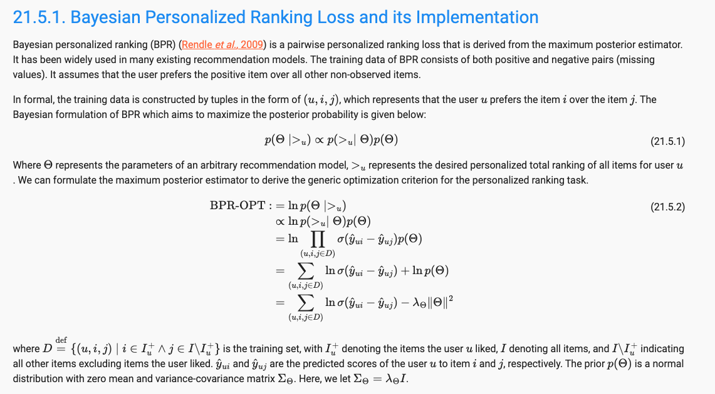
Personalized Ranking for Recommender Systems

Slide 9
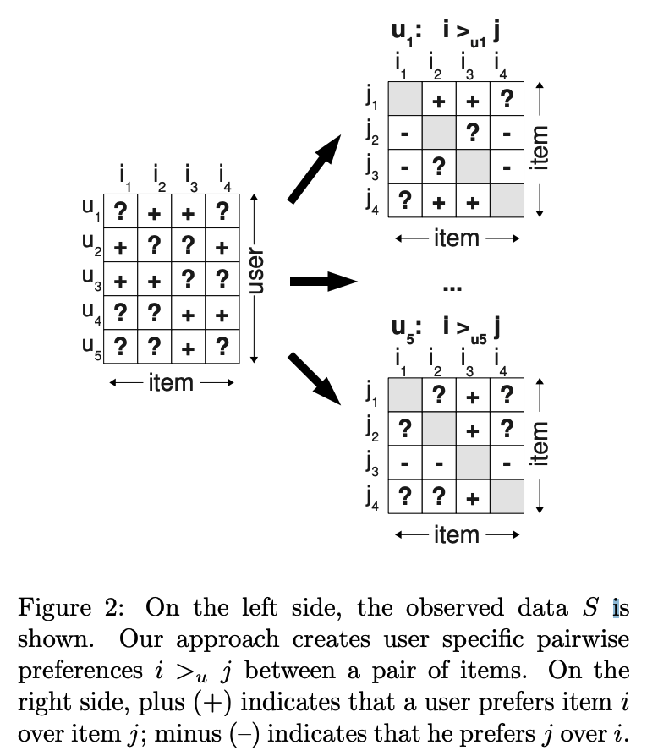
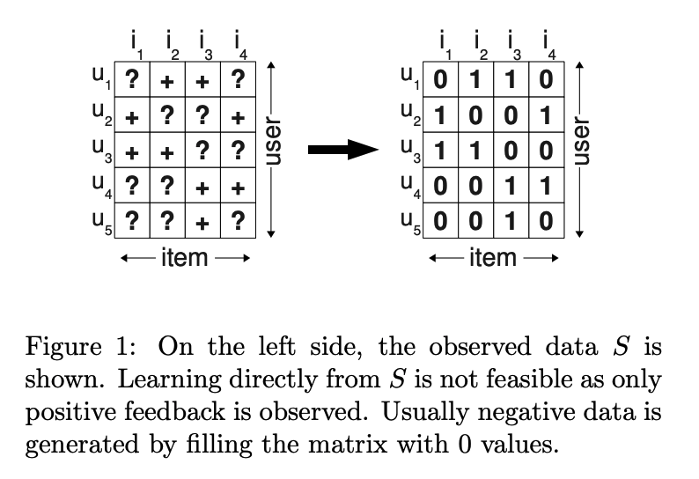
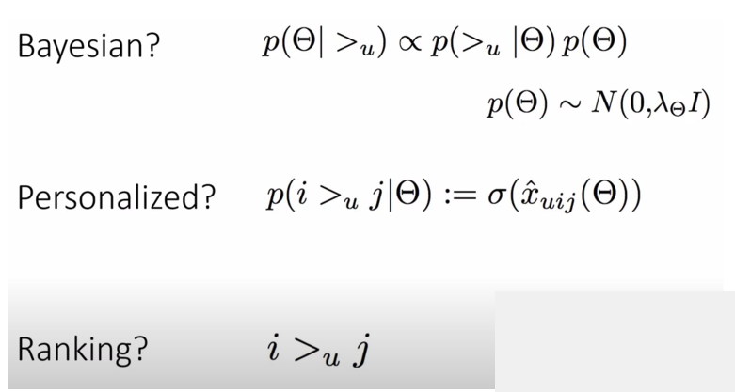
BPR
Source: Steffen et al, BPR: Bayesian Personalized Ranking from Implicit Feedback

Slide 10
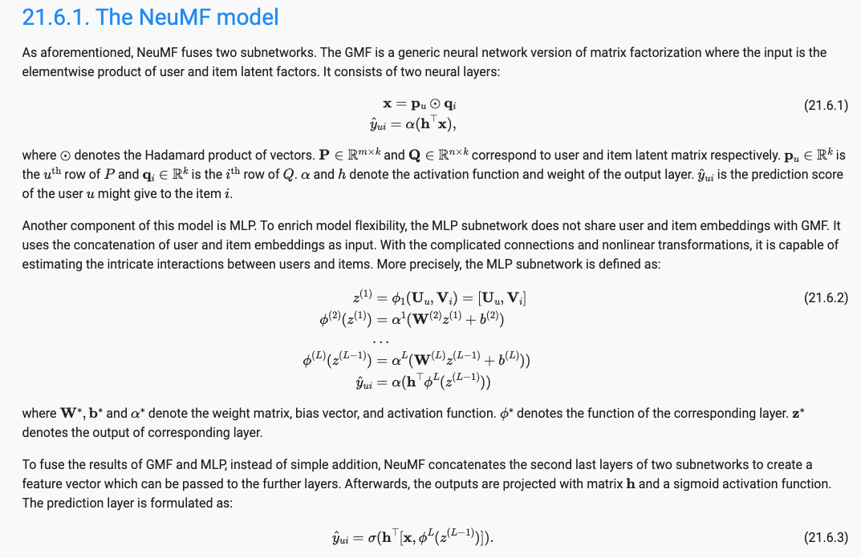
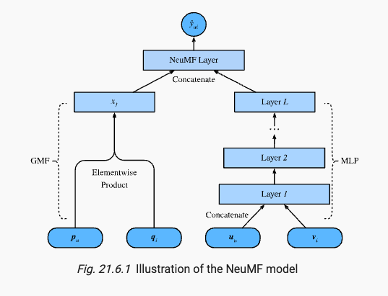
Neuro Collaborative Filtering for Personalized Ranking

Slide 11
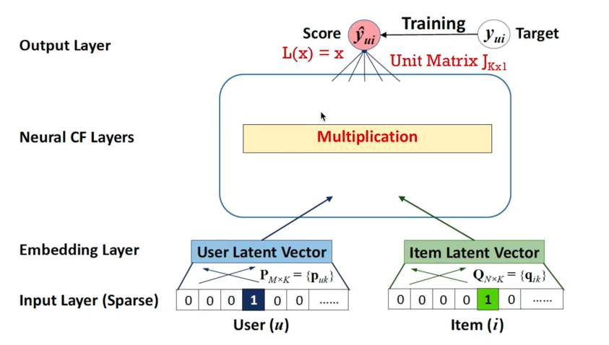
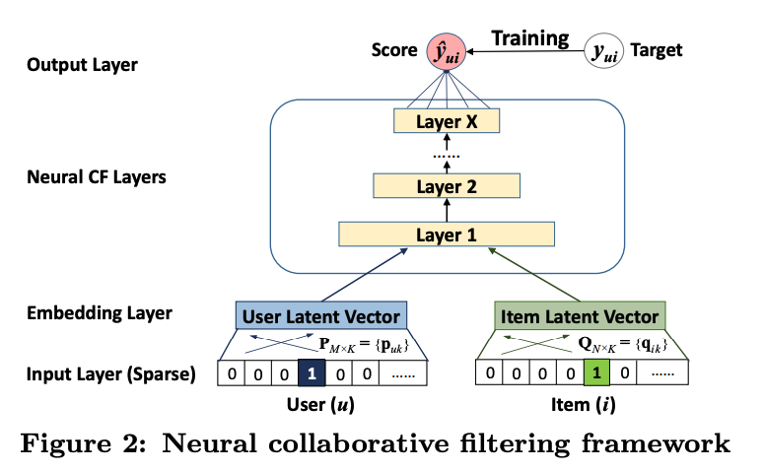
Neuro Collaborative Filtering for Personalized Ranking
Source: He et al, 2017, Neural Collaborative Filtering

Slide 12
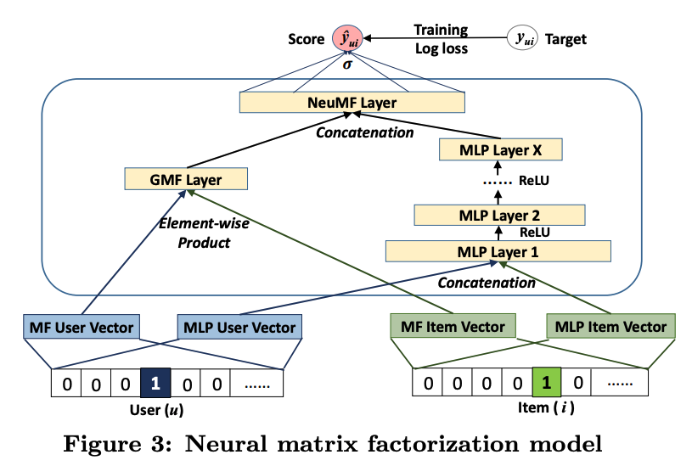
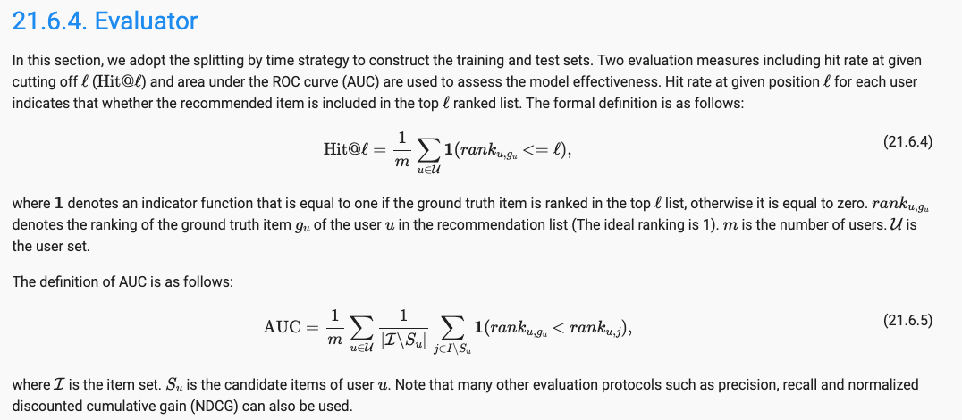
Neuro Collaborative Filtering for Personalized Ranking
Source: He et al, 2017, Neural Collaborative Filtering

Slide 13
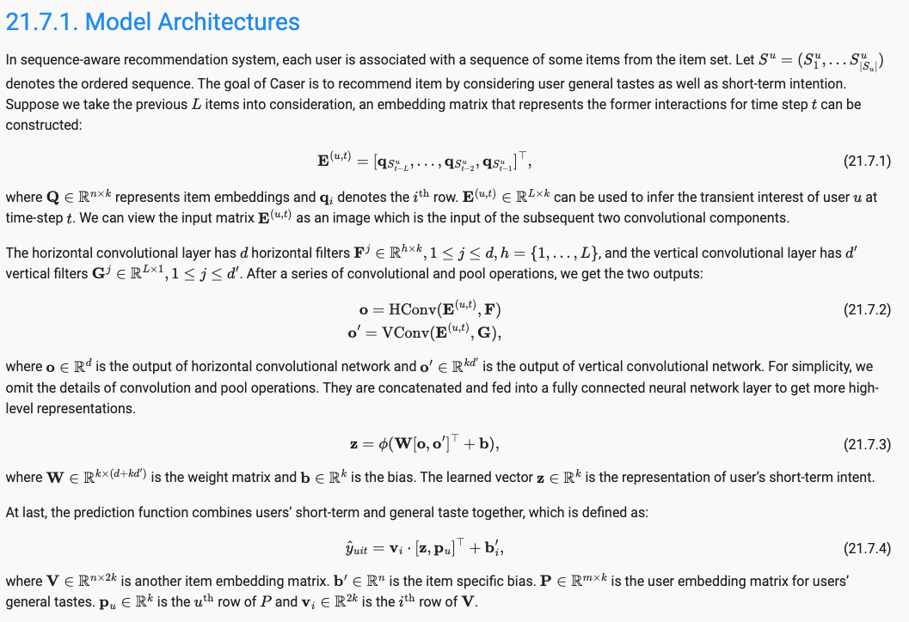
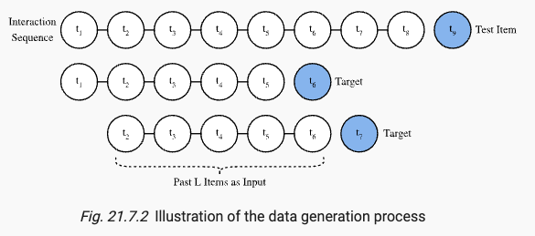
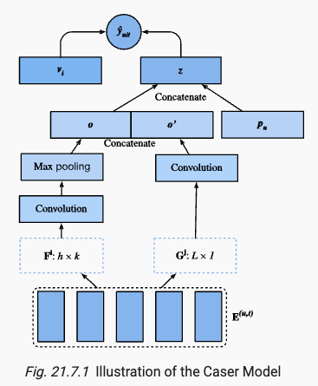
Sequence-Aware Recommender Systems

Slide 14
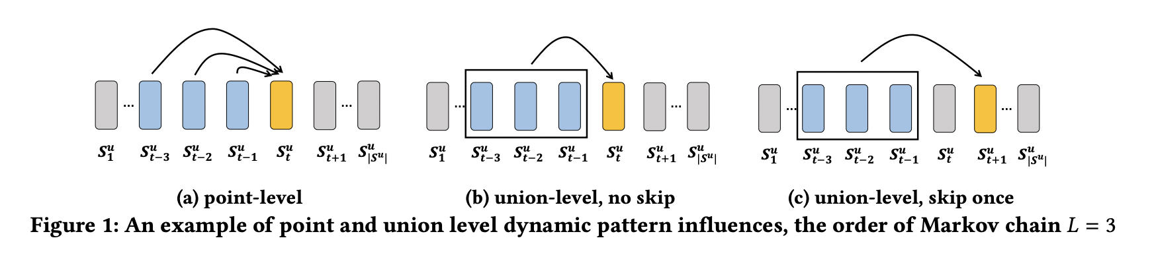
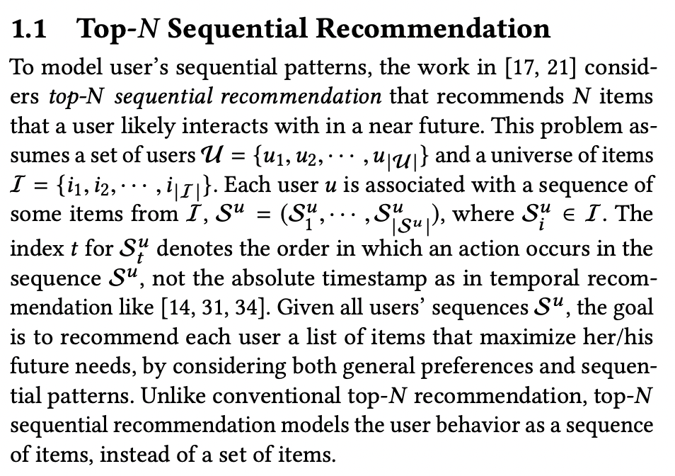
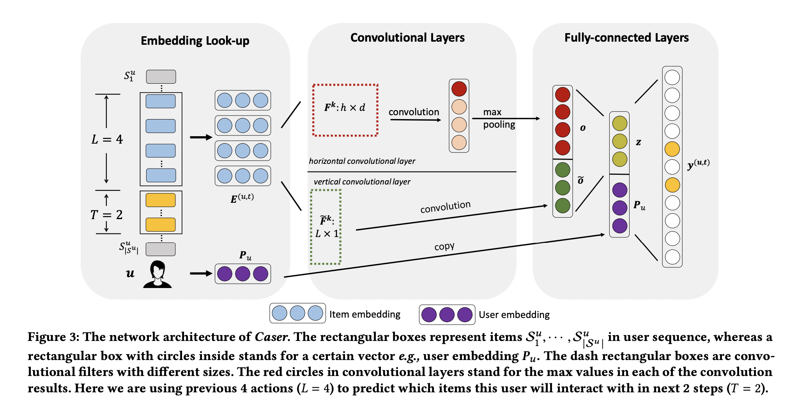
Caser
Tang et al, 2018, Personalized Top-N Sequential Recommendation via Convolutional Sequence Embedding

Slide 15
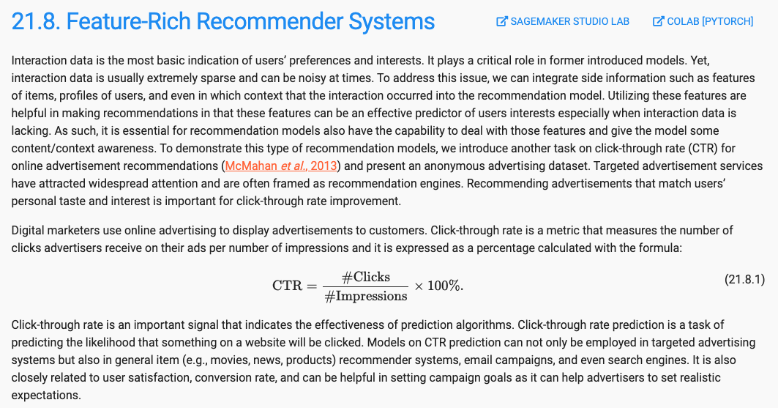
Feature-Rich Recommender Systems

Slide 16
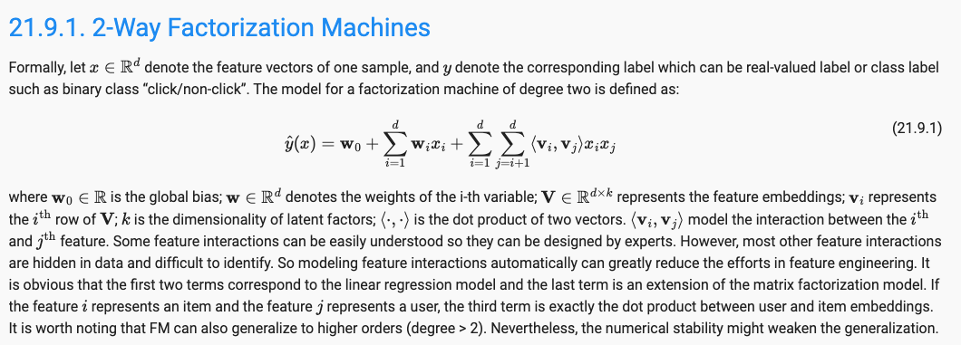
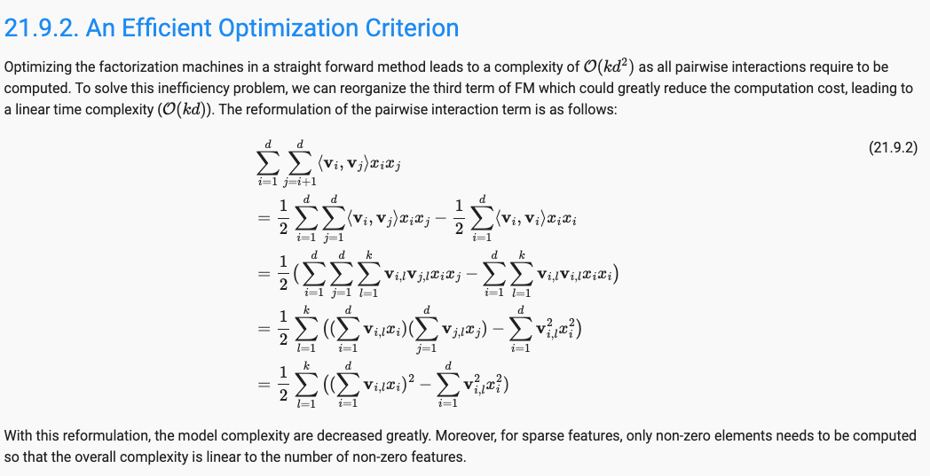
Factorization Machines

Slide 17
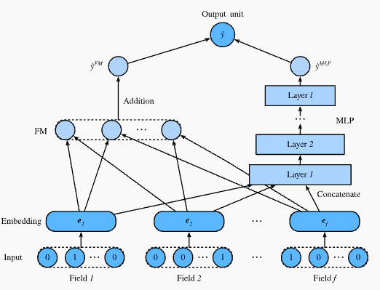
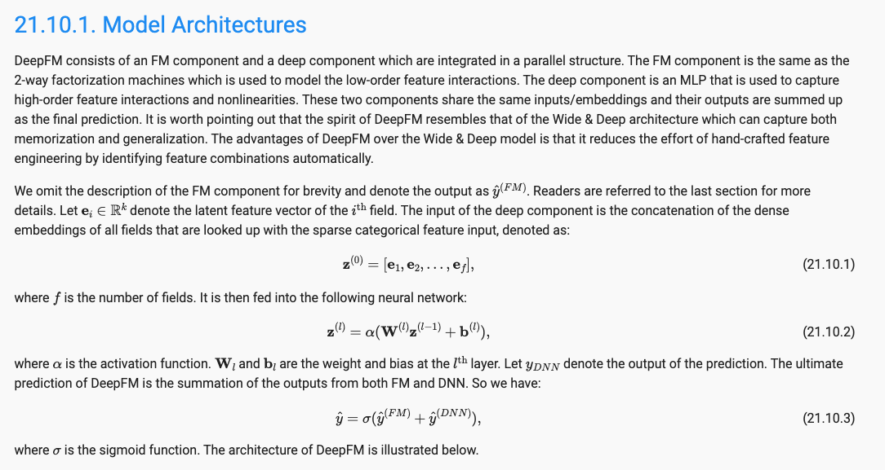
Deep Factorization Machines

Slide 18
References
Books
Charu Aggarwal, 2016, Recommender Systems: The Textbook, Springer

